Slide 1
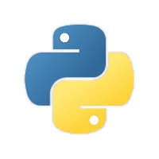
Python : Entry Level Training
Basic Topics on Python and corresponding exercises
2020 – Jan - 07
By : Aakaash Ramnath

Slide 2
Python and it’s features

Slide 3
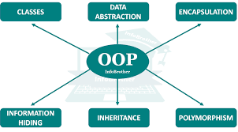
What is python ???
Python is an interpreted, high-level programming language.
Created by Guido van Rossum and first released in 1991, Python's design philosophy emphasizes code readability with its notable use of significant whitespace
General purpose object-oriented programming language.
Clear and easily understandable syntax, portability and easy to learn.
Although often referred as scripting language, it is also used as OOP and system programming.
Huge set of built-in packages for various applications.
Main tool in data science and machine learning fields.

Slide 4
Features of Python
Interpreted language, I see ….
Cross-Platform compatibility, Really???
Object-Oriented Language, OOPs I already knew it. Good…
Extensible, Amazing 😍
Large Standard Library, Hmmm….
GUI Programming support, Ahh !!! You made it pretty…
Free and Open source, Simply Wow !!!!
Integrated, You are my sweety .py
Reference 1 : https://www.javatpoint.com/python-features
Reference 2 : https://data-flair.training/blogs/features-of-python/

Slide 5
Download, Installation & Usage

Slide 6
Download & Installation
How to install and use Python?
Python comes built in for Mac OS and Linux. So you can kickstart by typing python in the shell or terminal to see the version of it
For MS Windows users, download python from https://www.python.org/ ( Please ask for Python setup – aramnath@mycervello.com or lgunasekar@mycervello.com )
For installation steps follow Method 1 in the following link → https://datatofish.com/add-python-to-windows-path/
After installing, type “python” in the command window. It shows the version of python you installed
If it didn’t show, either of it is the reason
Python is not installed properly
Python is not added to the environment variable
To add to environment variable, refer Method 2 → https://datatofish.com/add-python-to-windows-path/
The installation bundle comes with basic python packages and a shell by default
Reference 1 : https://datatofish.com/add-python-to-windows-path/
Reference 2 : https://superuser.com/questions/143119/how-do-i-add-python-to-the-windows-path

Slide 7
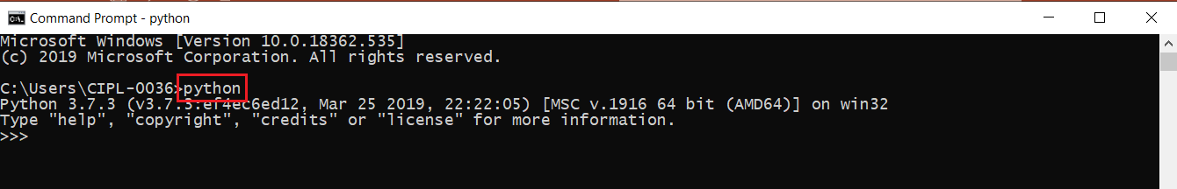
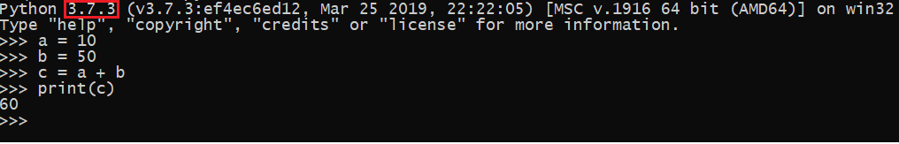
Usage
How to write Python code & Execute???
You can directly start coding in the command window itself. If you type “python” in the console, it will enter Python’s environment.
Image - usage.1
You can start writing your piece of code there and get the result
Image – usage.2
The one marked with red outline in the above image (usage.2) is the Python version

Slide 8
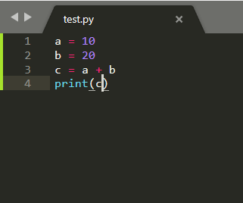
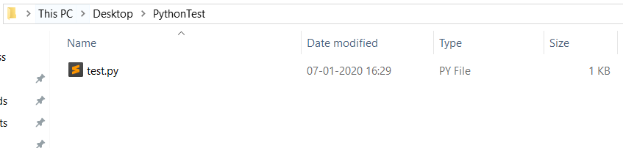
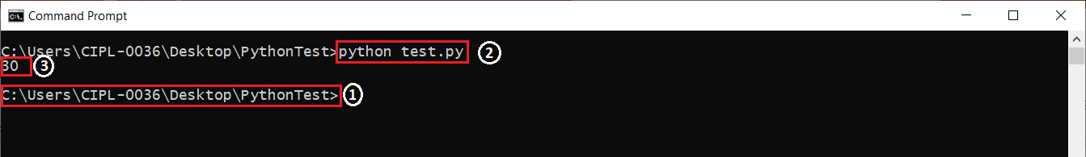
Usage
How to write Python code & Execute???
You can also write python code in a text editor like Notepad++, Sublime Text and preferably not Notepad since Python reads the code by indentation similar to how Java or C++ reads by braces {}.
Save the file with extension .py
Open the command line and navigate to the location where this code is saved and run this “python <filename>.py” to execute the code
1 → Path where the Python code is stored
2 → That’s how you execute the code
3 → Output

Slide 9


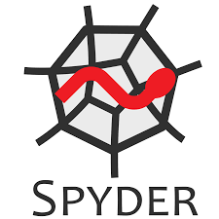

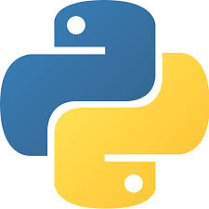

Usage
How to write Python code & Execute???
You can also use other Python Development Environments
General Editors & IDEs with Python Support
Eclipse + PyDev
Sublime Text
Atom
GNU Emacs
Vi/Vim
Visual Studio
Visual Studio Code
Python specific Editors and IDEs
PyCharm
Spyder
Thonny
Python computers like Anaconda

Slide 10
Setting up Jupyter Notebook

Slide 11
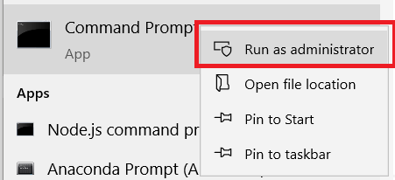
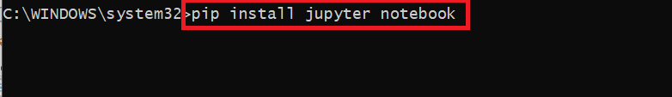
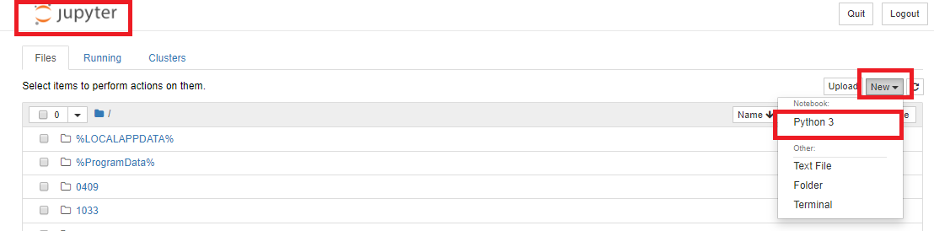
Install Jupyter Notebook
For using the learning-python3.ipynb file, you need Jupyter Notebook
Open command prompt with Administrator privileges
Type “pip install jupyter notebook” and Hit enter
Wait for it to install. Once it has completed, Type jupyter notebook in the console to open Jupyter notebook
If you want to open a notebook or create one in particular location, navigate to that location through command prompt and follow step 2
Note : Above steps will work only if you have set python/pip to your environment variable

